Slide 1
Advancement of Effective Circular Economy Practices in Smart Cities
By
Garimella Pavan Teja, Tia Celin Martin, Sri Harisha N. G.
Mentor: Prof. Swarnalatha P
VIT, Vellore

Slide 2
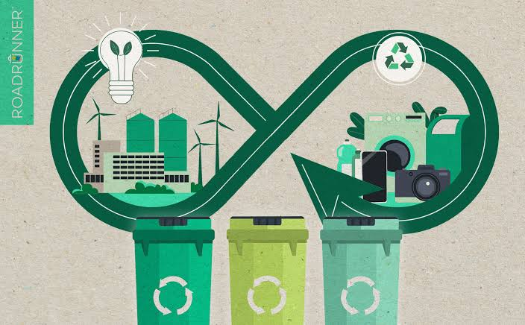
Introduction
Urban areas generate approximately 1.9 billion tons of waste annually; projected to quadruple in 10 years
Smart cities integrate digital tech for holistic problem-solving
Circular Economy (CE) promotes recycling, reuse, and regeneration to enhance sustainability

Slide 3
Objectives
Explore integration of CE with smart city technologies (IoT, AI, data analytics)
Identify barriers in tech adoption, governance, and public behavior
Develop frameworks and policy guidelines for CE in urban systems

Slide 4
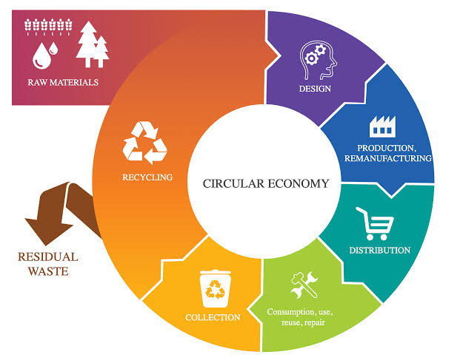
What is a Circular Economy?
It is an economic model prioritizing minimal waste, maximum resource use. It shifts from 'take-make-dispose' to reuse and regeneration
Principles:
Eliminate waste and pollution
Keep materials in use
Regenerate ecosystems

Slide 5
History of Circular Economy
1966: Kenneth Boulding introduces idea of 'Spaceship Earth'
1970s-90s: Concepts like industrial ecology, cradle-to-cradle, life cycle assessment emerge
2000s: EU and China adopt CE; Ellen MacArthur Foundation increases global awareness

Slide 6
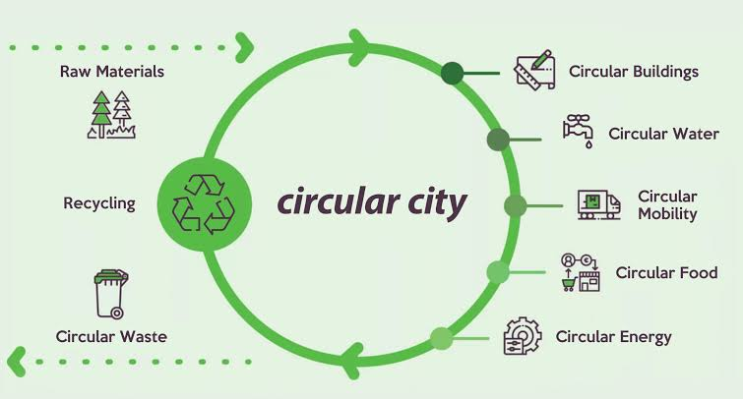
Circular Economy & Smart Cities: The Connection
CE complements smart cities by reducing emissions, improving efficiency
IoT, AI, blockchain enhance material tracking and reuse
Smart waste management, sharing economy, sustainable infrastructure

Slide 7
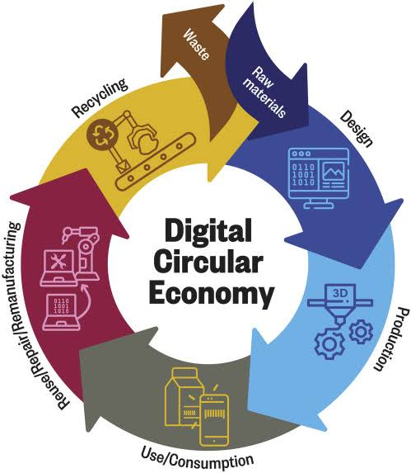
Technology in CE Implementation
Smart Bins with IoT sensors: optimize collection routes
AI & Robotics: reduce contamination in recycling
Blockchain: trace recycled materials across supply chains
Data analytics: enhance decision-making and planning

Slide 8
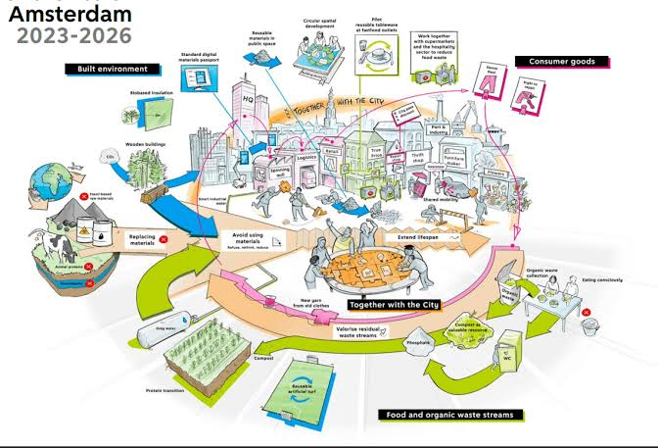
Policy & Governance
Amsterdam Circular Strategy: digital twins, recycled construction
Singapore Zero Waste Plan: WTE plants, NEWater recycling
Policy tools: tax incentives, penalties, regulatory frameworks

Slide 9
Implementation Challenges
High initial investment and uncertain ROI
Poor urban data access, fragmented policies
Lack of public awareness and habit-driven resistance
Technical scalability and cross-sector coordination issues

Slide 10
Our IoT-Based Solution
IoT-enabled bins with real-time waste data capture.
CAD-modeled infrastructure for simulation and design.
Smart city integration: waste sorting AI, route optimization.
Empirical evaluation through field testing and feedback.

Slide 11
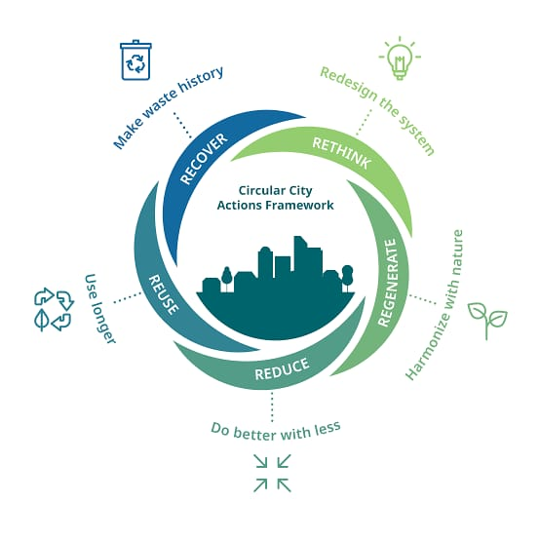
Future Outlook
Scalability to water, energy, and urban farming sectors
AI-driven policy optimization and predictive waste modeling
Promote cross-sectoral integration for urban sustainability

Slide 12
Conclusion
Practical, technology-backed CE framework for smart cities
Reduces waste, improves resource efficiency, supports policy
Supports data-driven, environmentally responsible urban growth

Slide 13
Thank You

